Slide 1
Voter Disenfranchisement and Turnout
Data Visualization Team Project
Constance, Kyle, Neville, Priyanka, Tyler

Slide 2
Background
U.S. Constitution grants the right to vote to all citizens over the age of 18
States limit who may vote in the interests of electoral integrity (guard against fraud) and as punishment for crimes
States regulate the election process (when & where voting happens)

Slide 3
Hypothesis
State regulation of the election process prevents otherwise eligible voters from casting a ballot
Neutral intent yields disproportionate impact
Higher turnout could have different electoral outcomes

Slide 4
Datasets
Election results - by county (excludes Alaska)
Census data - demographic details
Labor, ethnicity, income, education, disability
Voting Laws - by state
Voter ID, early voting days, and mail-in/absentee
Effective for 2016 Election

Slide 5
Ranking & Scaling Voting Ease
Voter ID
None or non-Photo ID; Strict non-Photo; Photo ID
Early Voting Days
18-45 days; 3-15 days; None
Vote by Mail
All mail ballots; Any absentee; Excuse only Absentee
Flexible: 3 & 4 Strict: 8 & 9

Slide 6
Low Income Voters - Disproportionate Impact
Low Income County definition:
Median Household income below $40,000 (25% of all counties)
Lack of paid time off, difficulty getting to polling locations

Slide 7
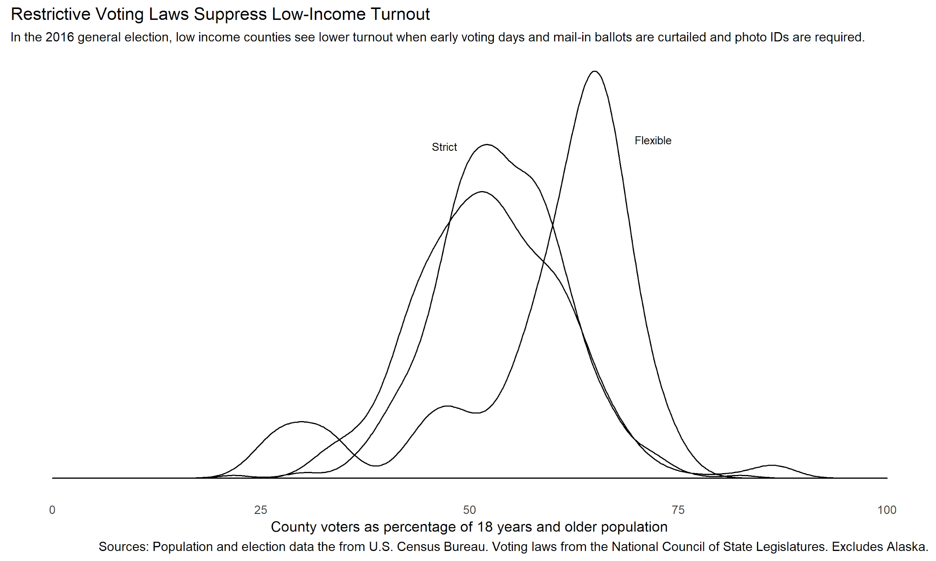
Finding 2

Slide 8
All Voters - Increased Turnout
Convenience: Time & Location
More deliberative, more engaging
No concerns about being turned away, no extra “hoops”

Slide 9
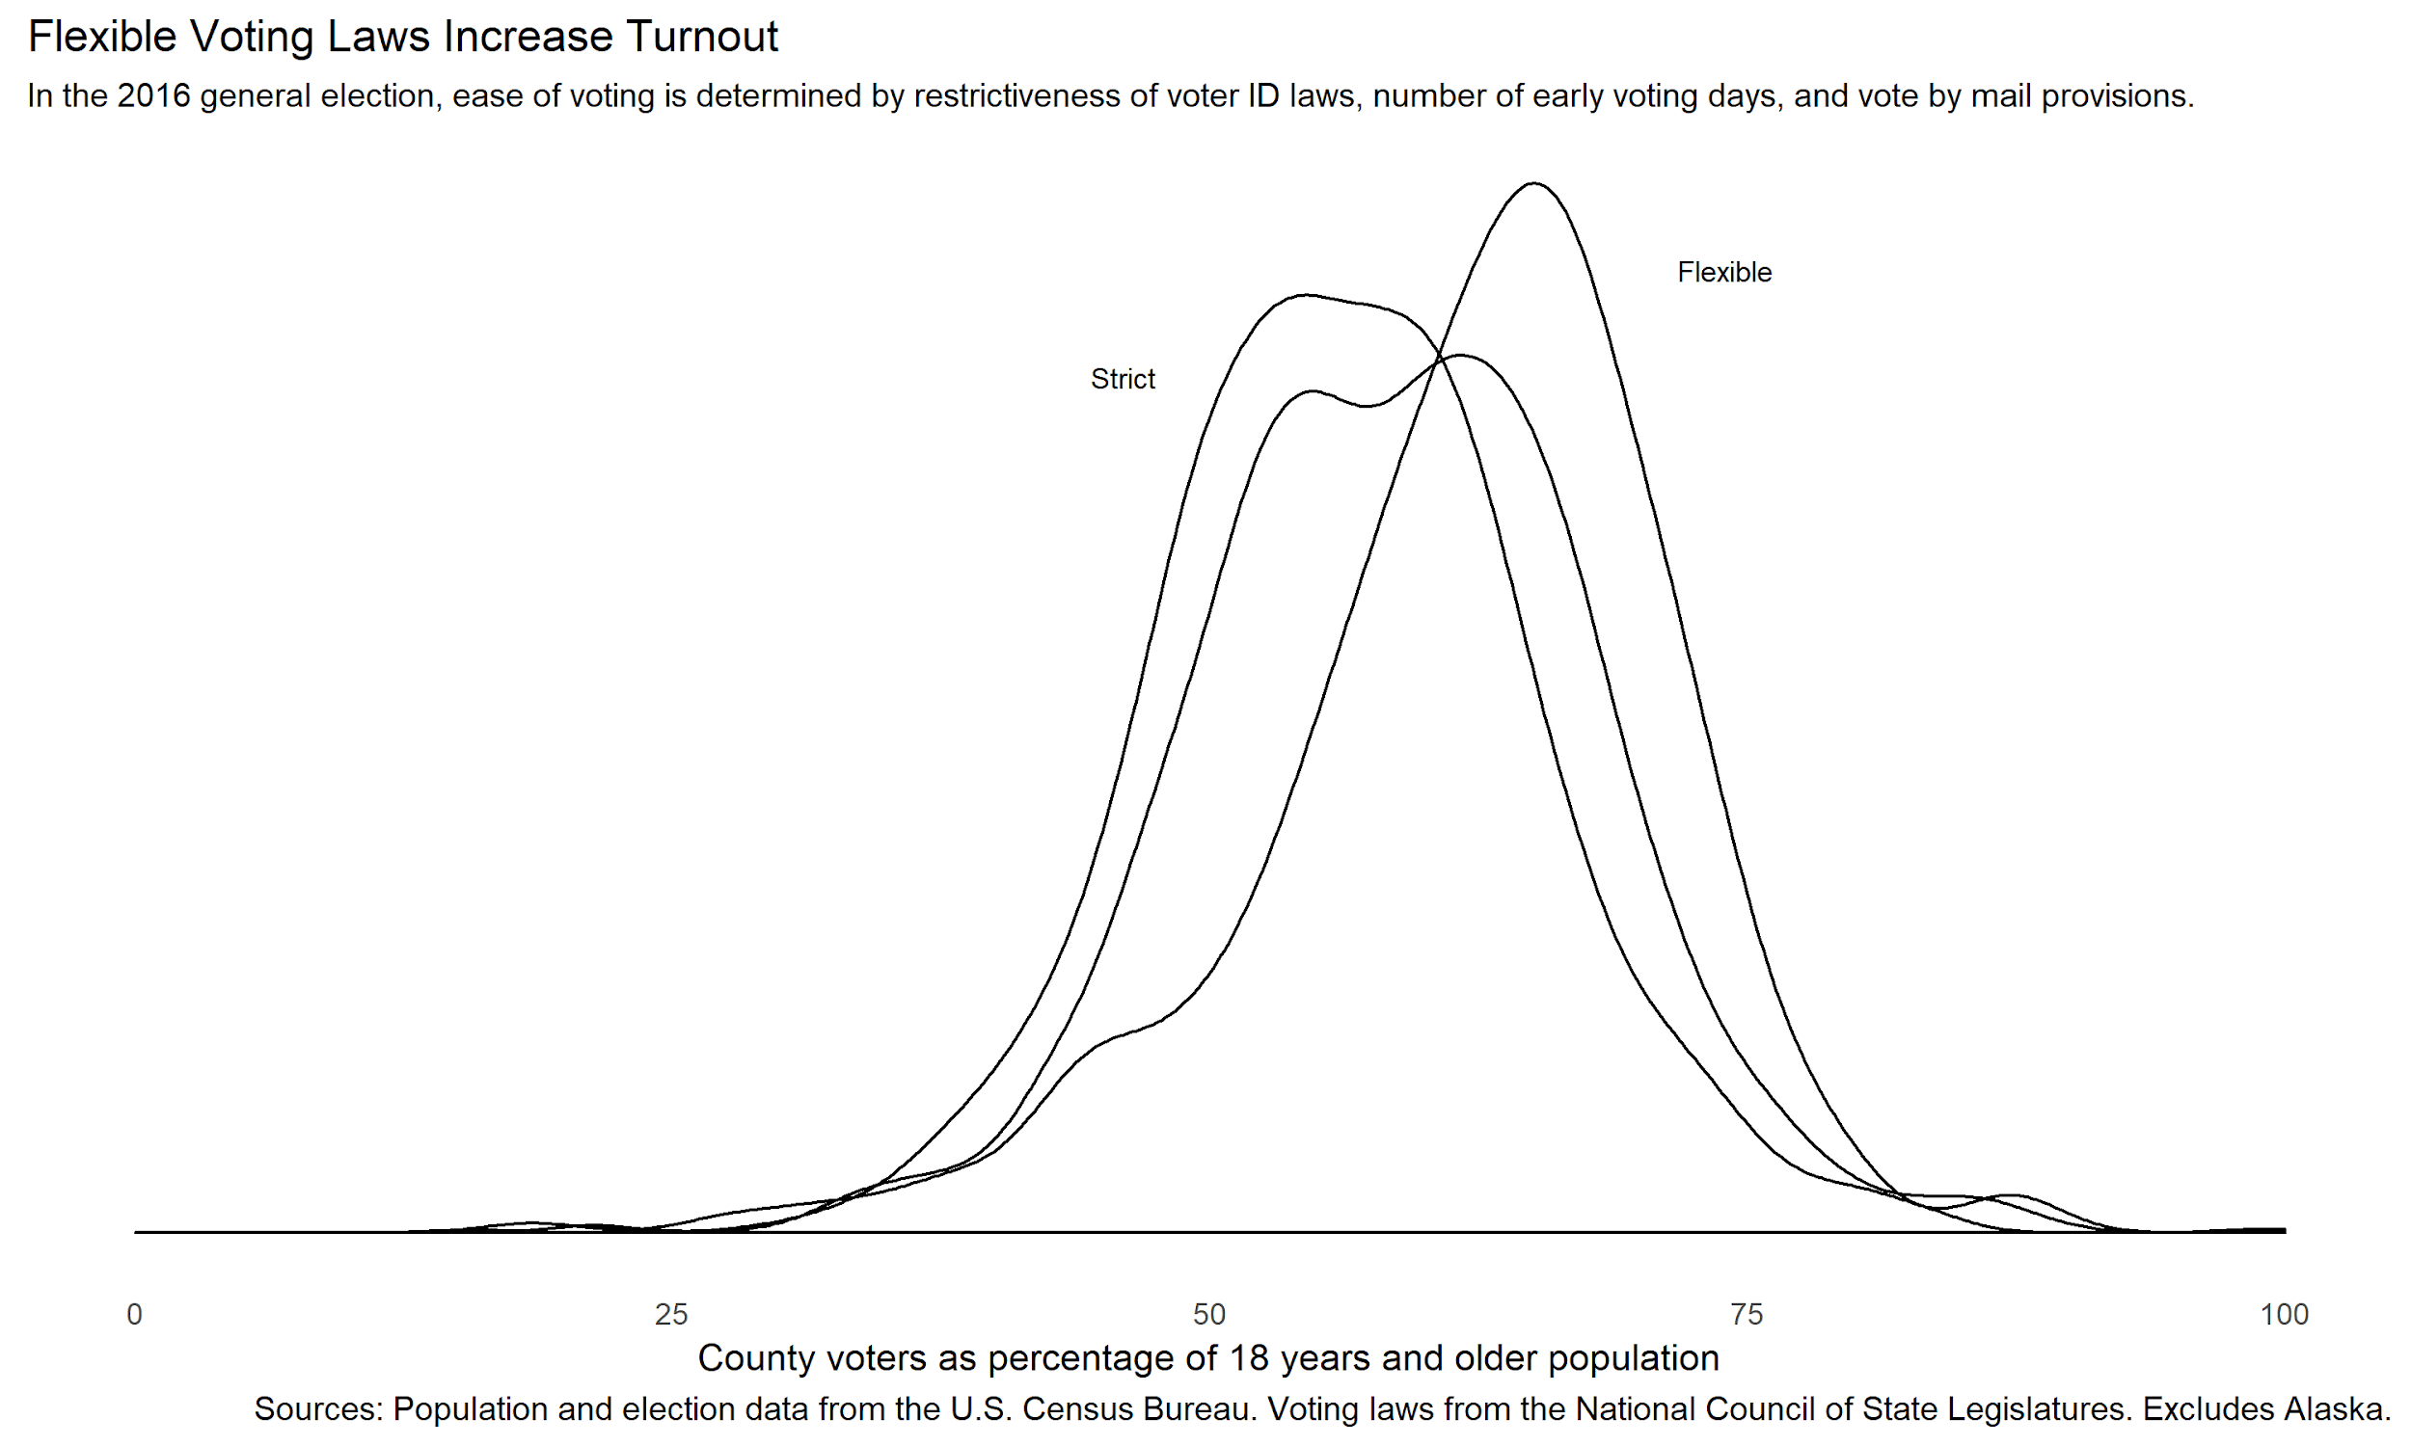
Finding 1
Mean turnout

Slide 10
Impact of Suppressed Voter Turnout
Close Races, Different Electoral Outcomes
Government does not reflect the people
Voter disengagement feedback loop
Racial discrimination

Slide 11
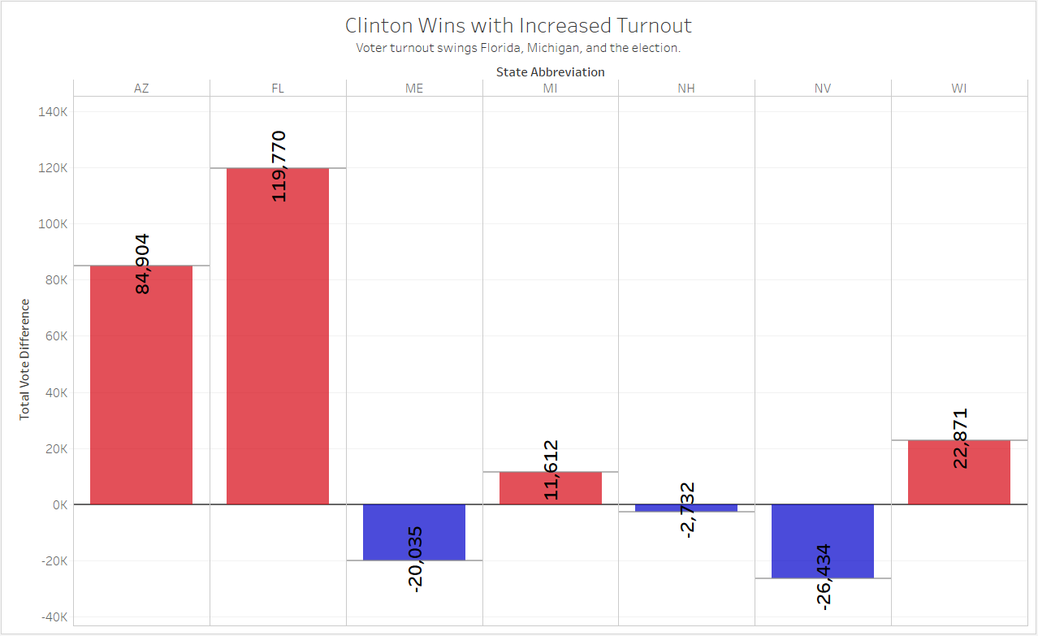
Notes:
Link to tableau public: https://public.tableau.com/profile/tyler.young#!/vizhome/TeamProjElection/StateDifferences

Slide 12
WE the PEOPLE
Close Races, Different Electoral Outcomes
Government does not reflect the people
Voter disengagement feedback loop
Racial discrimination
New laws and ballot initiatives for automatic voter registration and vote by mail are on the way!

Slide 13
Roadmap
Future features/enhancements:
Voting data based on demographics
Get registered voter data
Deeper dive into what affects turnout (ethnicity, felony)

Slide 14
THANK YOU !!

